Slide 1
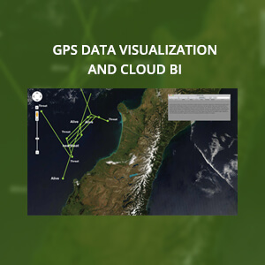
GPS Data Visualization and Cloud BI
The Challenge
<p>Our client needed to track and monitor hundreds of vehicles in real-time, while representing their position and status indicators through visual interfaces.<br />
Affirma was engaged to help solve this problem by collecting and storing relevant data, ultimately showing personnel these vehicles&rsquo; locations on a real-time basis from a 3D data visualization interface.</p>
What We Did
<ul>
<li>Affirma developed a network-centric web service that was installed on Navy ships. Data from the vehicle&rsquo;s control systems was collected on board the ship and synchronized with data from other ships in a central data repository.</li>
<li>Data collected on board the ship was stored in a SQL Server database, transmitted to shore and synchronized with data from other ships remotely in the cloud</li>
<li>Affirma created multiple 3D data visualization and other visual tools to allow for intuitive, user-friendly interpretation of data.</li>
</ul>
Results
<p>Navy personnel can quickly and easily track the position and status of these vehicles in real-time.<br />
Our client is extremely pleased with their cloud BI system as it met and exceeded its core functionality.</p>

